Slide 1
C PROGRAMMING
DAY 5
EDUCATION OUTREACH PROGRAM

Slide 2
ARRAYS
An array is a variable that can store multiple values.
For Eg:- if you want to store 100 integers then you can create an array for it.
Array stores values in contiguous memory locations.
The indexing of array starts from 0.
Size of array means how many value an array can store.
For Eg :- int x[100] ; , here x is an array of int type and can store 100 integers.
Lets see the code of array.
Array elements out of bound error.

Slide 3
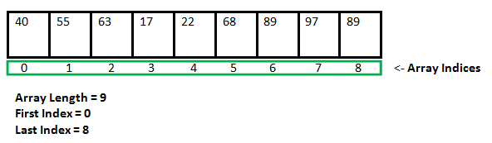
REPRESENTATION OF AN ARRAY

Slide 4
INSERTING AN ELEMENT IN AN ARRAY
First get input of the element to be inserted and the position.
Shift the array elements from this position to on position forward and do this for all elements next to pos
Insert the element at pos , since it is now empty.

Slide 5
DELETING AN ELEMENT FROM THE ARRAY
Get the position from where you want to delete the element.
Shift all the elements one step back that are there after pos to fill the empty space. The element to be deleted will be overwritten.
Reduce the size of array.

Slide 6
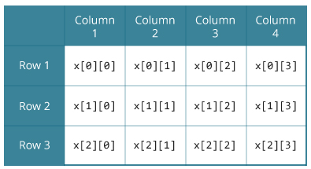
2D ARRAYS
In C programming we can create array of arrays. These arrays are known as multidimensional arrays.
Eg : - int x[3][4];

Slide 7
WAYS TO INITIALIZE A 2D ARRAY
int c[2][3] = {{1, 3, 0}, {-1, 5, 9}};
int c[ ][3] = {{1, 3, 0}, {-1, 5, 9}};
int c[2][3] = {1, 3, 0, -1, 5, 9};

Slide 8
BUBBLE SORT
Biggest bubble come out first. There will be n passes( n = elements)
Read more about it by clicking the link below
https://visualgo.net/bn/sorting?slide=6

Slide 9
INSERTION SORT
The array is searched sequentially and unsorted items are moved and inserted into the sorted sub-list (in the same array).
Read more about it by clicking the link below
https://visualgo.net/bn/sorting?slide=8

Slide 10
STRING DATA TYPE
Similar to array , string string are set of characters.
Every string value ends with a delimiter (\0)
Initialization of a string can be done as follows : -
Char s[ ] = { ‘a’ ,’b’,’c’,’d’,’\0’};
Char s[ ] = “abcdef”;
Char s[10] = “abcdef” ;

Slide 11
ARRAY OF STRING
Char[5][10] = {“white” , “red” , “green”, “blue”,”yellow”};
Char[5][10] = { { ‘w’,’h’,’i’,’t’,’e’,’\0’} , {....},{....}......};
w | h | i | t | e | \0
r | e | d | \0
g | r | e | e | n | \0
b | l | u | e | \0
y | e | l | l | o | w | \0

Slide 12
STRING LIBRARY FUNCTIONS
strlen( ) :- to calculate length of a string
strcmp( ):- to compare length of 2 strings
strcpy() :- copies one string to another
https://www.programiz.com/c-programming/library-function/string.h
0 | If both strings are same
-ve | If ASCII value of first unmatched character is less than second
+ve | If ASCII value of first unmatched character is greater than second

